Slide 1
Introduction to Algorithm Design
Lecture Notes 11

Slide 2
ROAD MAP
Iterative Improvement
  The Simplex Method
  Maximum Flow Problem
  Maximum Matching in Bipartite Graphs

Slide 3
Iterative Improvement
Definition :
  Iterative Improvement is an approach to designing algorithms for optimization problems.
  It starts with some feasible solution
    A solution that satisfies all the constraints of the problem
  Proceeds to improve it by repeated applications of some simple steps
  This step typically involves a small, localized change yieding a feasible solution with an improved value of the objective function
  When no such changes improves the value of the objective function, the algorithm returns the last feasible solution as optimal and stops

Slide 4
Iterative Improvement
There can be several obstacles to the successful implementation of this idea
First, we need an initial feasible solution
  Finding an initial solution may require as much effort as solving the problem
Second, we need to decide on possible changes
  it is not always clear what changes should be allowed in a feasible solution
  Need check efficiently whether the current solution is locally optimal and if not replace it with a better one
Third is an issue of local versus global extremum
  This is the most fundemental difficulty
  The approach may not produce the optimal solution

Slide 5
Iterative Improvement
There are important problems that can be solved by iterative-improvement algorithms
  Linear programming

Slide 6
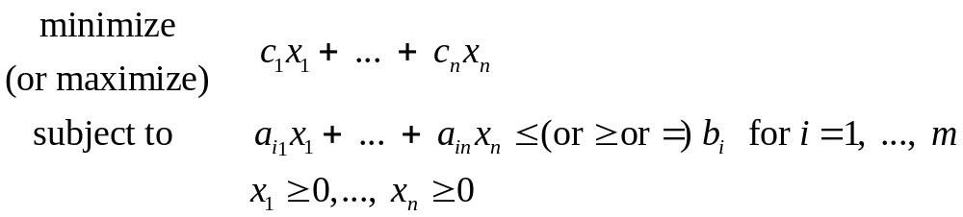
Linear programming
Linear programming is the general problem of optimizing a linear function of several variables subject to a set of linear constraints

Slide 7
Linear Programming
Example:
  Consider a university endowment that needs to invest $100 million
  This sum must be split between three types of investments
    stocks, bonds and cash
  Endowment managers expect an annual return of 10%, 7% and 3% for their stock, bond and cash investments
  Since stocks are most risky than bonds, endowment rules require the amount invested in stocks to be no more than one third of the moneys invested in bonds
  In addition, at least 25% of the total amount invested in stocks and bonds must be invested in cash
  How should the managers invest the money to maximize the return ?

Slide 8
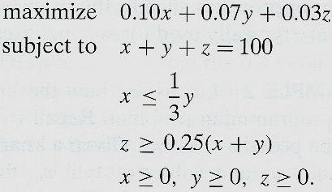
Linear Programming
Let, x, y, z be amounts invested in stocks, bonds and cash
So we can pose the following optimization problem

Slide 9
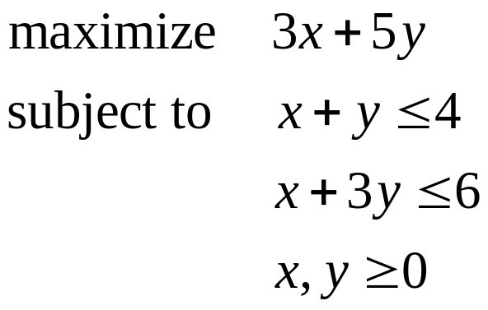
Geometric Interpretation of Linear Programming
  EX: Consider the following linear programming
feasible solution is any point (x,y) that satisfies all constraints of the problem
  Problem’s feasible region is the set of all its feasible points
  It is instructive to sketch the feasible region in Cartesian plane
optimal solution is to find a point in feasible region with largest value of z=3x+5y

Slide 10
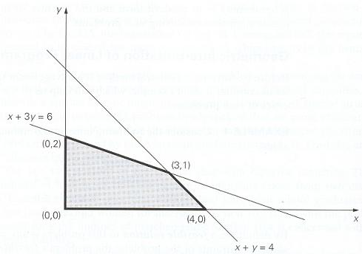
Feasible region of problem1 is convex polygon with vertices (0,0), (4,0), (0,2) and (3,1)
Last point which is the point of intersection of lines x+y=4 and x+3y=6, is obtained by solving linear equations
Feasible region of problem1

Slide 11
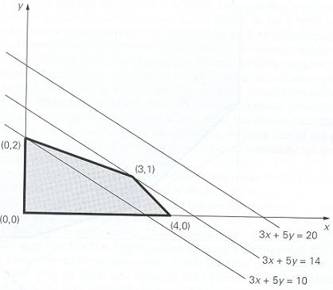
Solving a two dimensional linear programming problem geometrically

Slide 12
Geometric Interpretation of Linear Programming
Does every linear programming problem have an optimal solution?
  No
  The feasible region of a linear programming can be empty
    Called infeasible
  The feasible region of a linear programming problem can be unbounded
    its objective function may not attain a finite optimal value on it

Slide 13
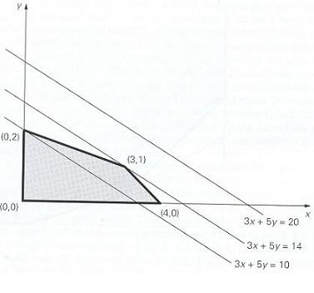
Unbounded feasible region of a linear programming problem with constraints x+y≥4, x+3y≥6, x≥0 and y≥0
and three level lines of the function 3x+5y

Slide 14
Geometric Interpretation of Linear Programming
An optimal solution to a linear programming problem can be found at one of the extreme points of its feasible region
Theorem (Extreme Point Theorem):
  Any linear programming problem with a nonempty bounded feasible region has an optimal solution
  An optimal solution can always be found at an extreme point of the problem’s feasible region

Slide 15
Geometric Interpretation of Linear Programming
This theorem implies that, to solve a linear programming problem, we can ignore all but a finite number of points in its feasible region
We can compute the value of the objective function at each extreme point and selecting the one with the best value
To major obstacles for it
  Need for a mechanism for generating the extreme points of the feasible region
  Number of extreme points grow exponentially

Slide 16
Geometric Interpretation of Linear Programming
We need an algorithm that inspects only a small fraction of extreme points of feasible region before reaching an optimal one
The famous one is Simplex Method

Slide 17
Simplex Method
Idea:
  Start by identifying an extreme point of the feasible region
  Check whether one can get an improved value of the objective function by going to an adjacent extreme point
  If it is not the case, current point is optimal – stop
  If the case, proceed to an adjacent extreme point with an improved value of the objective function
  After a finite number of steps, the algorithm will either reach an extreme point where an optimal solution occurs or determine that no optimal solution exists

Slide 18
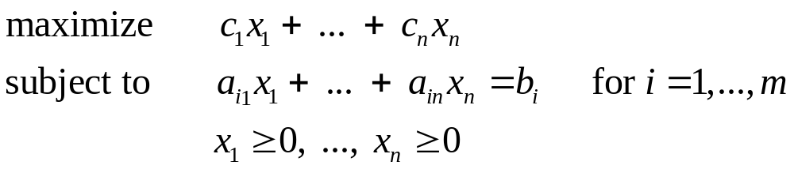

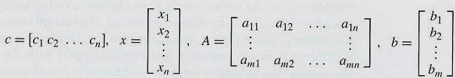
Simplex Method
General linear programming problem in standart form with m constraints and n unknowns (n≥m) is
It can also be written in compact matrix notations
where

Slide 19
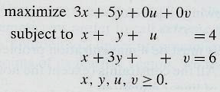
Simplex Method
The linear programming problem on the left can be transformed into equivalent standart form problem (on the right) in four variables
If we find an optimal solution (x*, y*, u*, v*) to the problem on the right, we can obtain an optimal solution for the problem on the left

Slide 20
Simplex Method
An advantage of the standard form
  Finding the feasible region and extreme points are easy
If m=n, need to solve linear system Ax=b
  There is only one solution, it is optimal if the solution is feasible
    If all the coordinates are nonnegative
If m>n, there is a feasible region
  An extreme point can be obtained by finding a basic solution of the linear system
    The solution found by setting m-n unknowns to zero

Slide 21
Simplex Method
Simplex method progresses through a series of adjacent extreme points with increasing values of the objective function
Starting from a basic solution
  Which is feasible

Slide 22

Simplex Method
In the above example:
Set x and y to be zero.
The basic solution is [0,0,4,6]

Slide 23
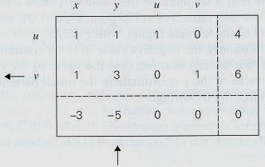
Each extreme point is represented by a simplex tableau
  A table storing information about basic feasible solution corresponding to extreme point
Simplex tableau of the problem is represented below

Slide 24
Last row of a simplex tableau is called objective row
Basic feasible solution (0,0,4,6) represented by tableau is not optimal
  Negative value in x column signals the fact that we can increase the value of objective function z=3x+5y+0u+0v
We can compensate x value
For this two conditions must be satisfied
x+u = 4 where u ≥ 0
x+v = 6 where v ≥ 0
which means that
x ≤ min {4,6} = 4
If we increase x from 0 to 4,
z will be 12

Slide 25
Negative value in y column signals the fact that we can increase the value of objective function z=3x+5y+0u+0v
We can compensate y value
For this two conditions must be satisfied
y+u = 4 where u ≥ 0
3y+v = 6 where v ≥ 0
which means that
y ≤ min {4/1,6/3} = 2
If we increase y from 0 to 2,
z will be 10
If there are several negative entries in objective row, a commonly rule is to select the most negative one !

Slide 26
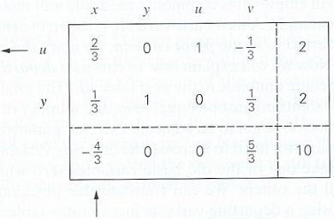
Simplex Method

Slide 27
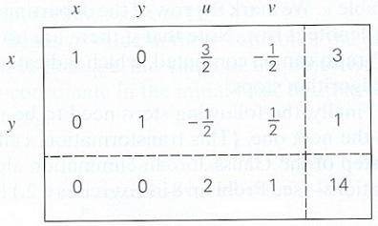
Simplex Method

Slide 28
Simplex Method
Summary:
  Step 1 : Initialization
  Step 2 : Optimality test
  Step 3 : Finding the entering variable
  Step 4 : Finding the departing variable
  Step 5 : Forming next tableau

Slide 29
ROAD MAP
Iterative Improvement
  The Simplex Method
  Maximum Flow Problem
  Maximum Matching in Bipartite Graphs

Slide 30
The Maximum-Flow Problem
We will consider the important problem of maximizing the flow of a material through a transportation network
  Pipeline system, communication system, …
We will assume that the transportation network in question can be represented by a connected weighted digraph.

Slide 31
The Maximum-Flow Problem
Transportation network: a connected weighted digraph with n vertices (numbered from 1 to n) :
Source: the vertex with no entering edges
  There is exactly one source which is numbered 1
Sink: the vertex with no leaving edges
  There is exactly one source which is numbered n
The weight u_{ij} of a directed edge (i,j) is a positive integer
  called the edge capacity
A graph satisfies these properties is called flow network or simply network

Slide 32
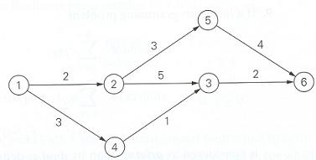
The Maximum-Flow Problem
A network graph

Slide 33

The Maximum-Flow Problem
It is assumed that source and sink are the only source and destination of the material, respectively
All other vertices can serve only as points where a flow can be redirected without consuming or adding any amount of the material
Total amount of the material entering an intermediate vertex must be equal to the total amount of the material leaving the vertex
This condition is called flow-conservation requirement

Slide 34

The Maximum-Flow Problem
The amount of the material should not change by going through intermediate vertices of network
  total amount of the material leaving the source must end up at the sink
So we can say that
Total outflow from the source – or, total inflow into the sink is value of the flow and we denote it by v

Slide 35

The Maximum-Flow Problem
A feasible flow is an assignment of real numbers xij to edges (i,j) of a given network that satisfy flow-conservation constraints and capacity constraints

Slide 36
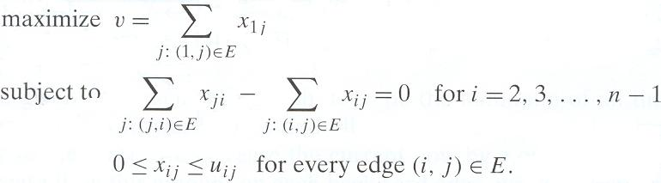
The Maximum-Flow Problem
Maximum-flow problem can be stated as following optimization problem
We can solve this problem with simplex method or another algorithm

Slide 37
The Maximum-Flow Problem
Alternatively: Ford Fulkerson Method
augmenting-path method
Start with the zero flow
On each iteration of the algorithm, try to find a path from source to sink along which some additional flow can be sent
Such a path is called flow-augmenting path
If a flow augmenting path is found
  adjust the flow along the edges of this path to get a flow of an increased value
  try to find an augmenting path for the new flow
If no augmenting flow is found, we conclude that the current flow is optimal

Slide 38
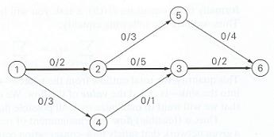
The Maximum-Flow Problem
Illustration of augmenting-path method

Slide 39
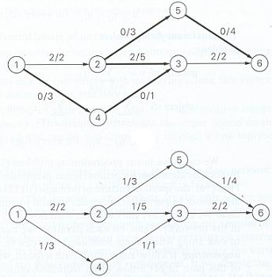

Slide 40
The Maximum-Flow Problem
In an augmenting path, consecutive vertices i and j should be connected by
  forward edge: directed edges from i to j with positive unused capacity r_{ij}=u_{ij}-x_{ij}
  backward edge: directed edges from j to i with positive flow x_{ji}
Since edge capacities are all integers, flow value is increased by one after on each iteration of augmenting path evaluation.
So, the maximum number of iterations is bounded by the maximum flow value which is a finite integer

Slide 41
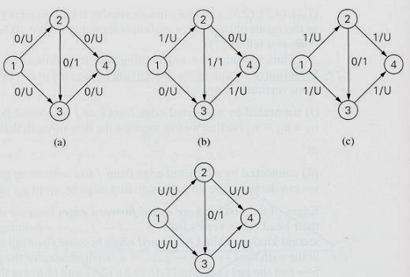
The Maximum-Flow Problem
Efficiency degradation of augmenting-path method
  The number of iterations is equal to upper bound

Slide 42
The Maximum-Flow Problem
There are several ways to generate flow-augmenting paths efficiently
The simplest of them uses breadth-first search to generate augmenting paths with the least number of edges
  This version is called shortest-augmenting-path

Slide 43
The Maximum-Flow Problem
Shortest-augmenting-path Algorithm:
Each vertex v is labeled with (l,w,sign)
  l = the amount of additional flow that can be brought from the source to v
  w = the vertex from which v is reached
  sing = + or – to indicate the edge is forward or backward
The source has label: infinity, Null, -
If a j is reached from i with a forward edge
  Label of j : min(l_{i},r_{ij}), i, +
If a j is reached from i with a backward edge
  Label of j : min(l_{i},x_{ji}), i, -

Slide 44
The Maximum-Flow Problem
Shortest-augmenting-path Algorithm:
After the sink is labeled, augmentation is performed i.e., all capacities and flows are updated
If the sink is unlabeled after a bread-first traversal, the algorithm terminates
  Optimal value is reached

Slide 45
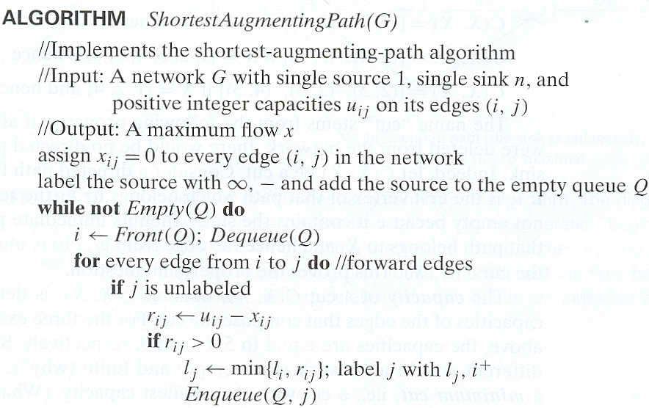

Slide 46
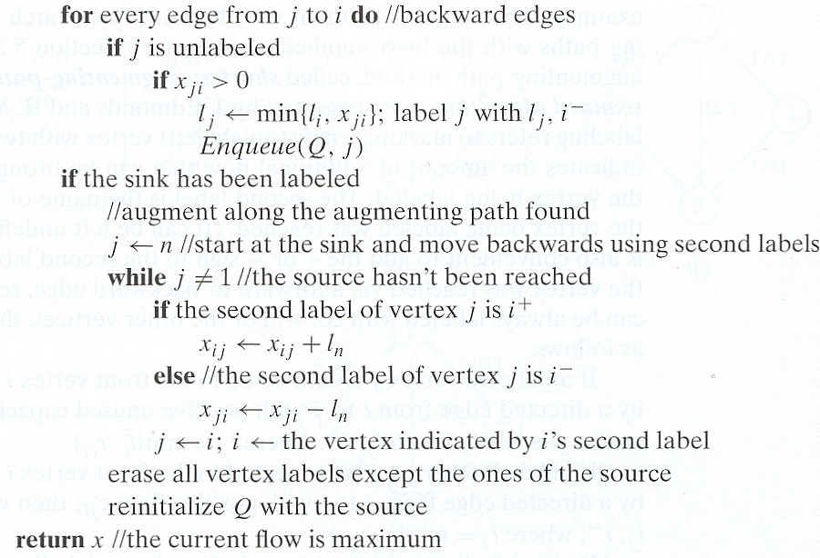

Slide 47
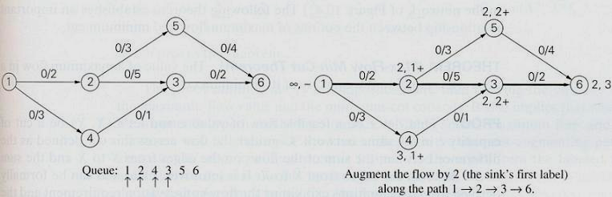
The Maximum-Flow Problem
Illustration of shortest-augmenting path algorithm

Slide 48
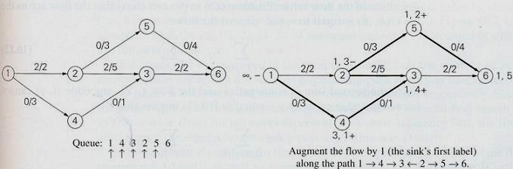

Slide 49
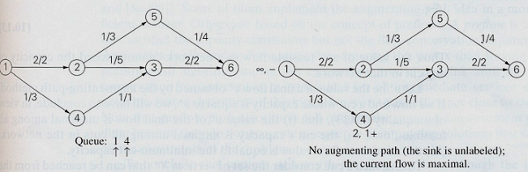

Slide 50
The Maximum-Flow Problem
Analysis:
  It is proved that the number of augmenting paths needed by the shortest-augmenting-path algorithm never exceed nm/2, where n and m are number of vertices and edges, respectively
  Since the time required to find a shortest augmenting path by breadth-first-search is O(n+m)=O(m) for networks represented by their adjacency list,
  Time efficiency of the shortest-augmenting-path algorithm is O(nm²)

Slide 51
The Maximum-Flow Problem
Optimality Proof:
By using network cuts
Cut C(X,Y): is a set of edges, partitioning the vertices into two sets X and Y
  X contains the source
  Y contains the sink
  The edges in the cut has its tail in X and its head in Y
The capacity of a cut is the sum of the cpacities of the edges in the cut
The minimum cut is the cut with the smallest capacity

Slide 52
The Maximum-Flow Problem
A network graph

Slide 53
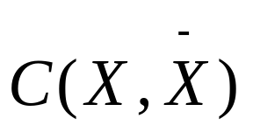
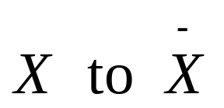
The Maximum-Flow Problem
Theorem : (Max-Flow Min-Cut Theorem)
  The value of maximum flow in a network is equal to the capacity of its minimum cut
Proof :
  Let x be a feasible flow of value v and let be a cut of capacity c in same network
  Consider the flow accross this cut defined as the difference between the sum of flows on the edges from

Slide 54



So it is clear that
Since the second sum is nonnegative and the flow x_{ij} on the edge (i,j) can not exceed the edge capacity u_{ij}, equality implies that
Thus value of any feasible flow in a network can not exceed the capacity of any cut in that network

Slide 55
Let v* be the value of a final flow x* obtained by augmenting-path method.
If we find a cut whose capacity is v*
  value v* of the final flow is maximal along feasible flows
  the cut’s capacity is minimal among all cuts in the network
  the maximum-flow value is equal to the minimum-cut capacity

Slide 56
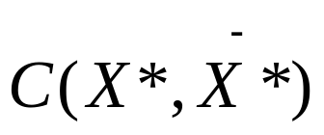
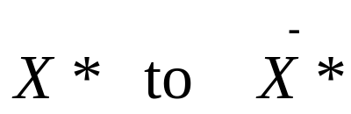

To find such a cut, conside the set of vertices X* that can be reached from the source by following an undirected path composed of forward edges with positive unused capacities and backward edges with positive flows on them
Consider the cut
Each edge (i,j) from has the zero unused capacity

Slide 57
ROAD MAP
Iterative Improvement
  The Simplex Method
  Maximum Flow Problem
  Maximum Matching in Bipartite Graphs

Slide 58
Maximum Matching in Bipartite Graphs
In many situations we are faced with a problem of pairing elements of two sets
It is convenient to represent elements of two given sets by vertices of a graph
  with edges between vertices that can be paired
A maximum matching is a matching with the largest number of edges
So maximum matching problem is the problem of finding a maximum matching in a given graph
For an arbitrary graph, this is a rather difficult problem

Slide 59
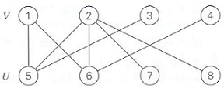
Maximum Matching in Bipartite Graphs
Bipartite Graph
  Definition:
  All vertices can be partitioned into to disjoint sets V and U (not necessarily of the same size)
    So that every edge connects a vertex in one of these sets to a vertex in the other set
  All vertices can be colored in two colors
    So that every edge has its vertices colored in different colors
Bipartitite Graph

Slide 60
Maximum Matching in Bipartite Graphs
Let’s apply the iterative-improvement technique to the maximum-matching problem
Let M be a matching in a partitite graph G = (V, U, E)
How can we improve it, find a new matching with more edges ?

Slide 61
Maximum Matching in Bipartite Graphs
Obviously, if every vertex in either V or U is matched, serves as an endpoint of an edge in M, this can not be done and M is a maximum matching.
Therefore to have a chance at improving the current matching, both V and U must contain unmatched vertices
  Vertices that are not incident to any edge in M

Slide 62
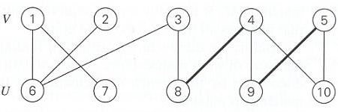
Maximum Matching in Bipartite Graphs
For the matching M_{a} = { (4,8), (5,9) }
Vertices 1, 2, 3, 6, 7 and 10 are free
Vertices 4, 5, 8 and 9 are matched
The path is called augmenting path
Augmenting path: 1, 6

Slide 63
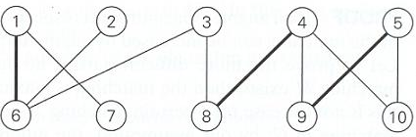
Maximum Matching in Bipartite Graphs
Adding (1,6) to the previous graph increase the current matching
M_{b} = { (4,8), (5,9), (1,6) }
Augmenting path : 2, 6, 1, 7

Slide 64
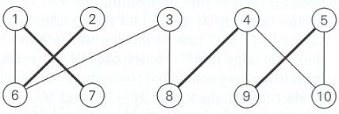
Maximum Matching in Bipartite Graphs
If we add (2, 6), we have to remove (1,6); but we can select (1,7) instead of (1,6)
M_{c} = { (1,7), (2,6), (4,8), (5,9) }
Augmenting path : 3, 8, 4, 9, 5, 10

Slide 65
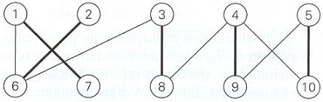
Maximum Matching in Bipartite Graphs
We then add (3,8), (4,9), (5,10) and we delete (4,8), (5,9)
M_{d} = { (1,7), (2,6), (3,8), (4,9), (5,10) }
Matching M_{d} is not only a maximum matching but also perfect

Slide 66
Maximum Matching in Bipartite Graphs
Theorem :
  A matching M is maximal iff there exists no augmenting path with respect to M
Proof:
If an augmenting path with respect to a matching M exists, the size of matching can be increased by augmentation and can not be maximal
How can we prove that, if no augmenting path with respect to a matching M exists, then the matching is maximal ?

Slide 67
Maximum Matching in Bipartite Graphs
Assume that, on the contrary, this is not the case for a certain matching M in the graph G
Let M* be a maximum matching in G
  By our assumption the number of edges in M* is the least one more than the number of edge
    |M*| > |M|
Consider the edges in the symmetric difference
Note that, |M*-M|>|M-M*| because |M*| > |M| by assumption

Slide 68


Let G’ be the subgraph of G made up of all the edges in
and their endpoints
By definition of matching, any vertex in can be incident to no more edge in M and no more edge in M*
Hence each of the vertices in G’ has degree 2 or less
Therefore every connected component of G’ is either a path or an even-length cycle of alternating edges from M-M* and M*-M
Since |M*-M|>|M-M*| and the number of edges from M-M* and M*-M is the same for any even-length cycle of alternating edges in G’, there must exist at least one path of alternating edges that starts and ends ith an edge from M*-M
Therefore every connected component of G’ is either a path or an even-length cycle of alternating edges from M-M* and M*-M
Hence this is an augmenting path for the matching M, which contradicts the assumption that no such path exists

Slide 69
Maximum Matching in Bipartite Graphs
Approach:
  Start with some initial matching (e.g., empty set)
  Find an augmenting path and augment the current matching along this path
  When no augmenting path can be found, terminate the algorithm and return the last matching which is maximal

Slide 70
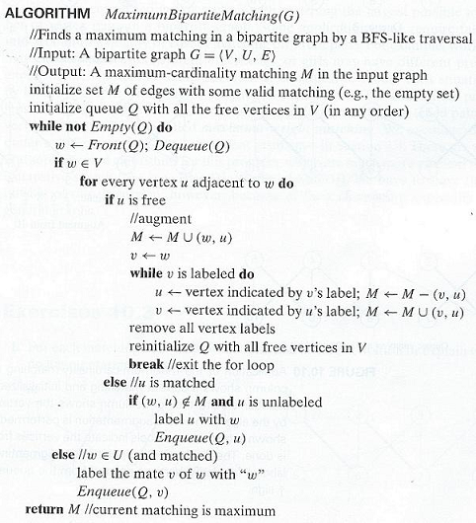

Slide 71
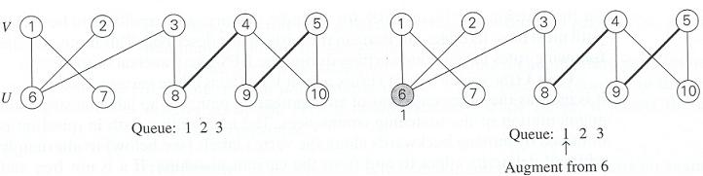
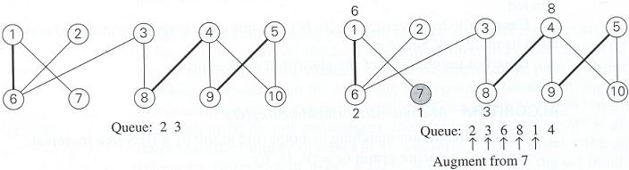
Example :

Slide 72
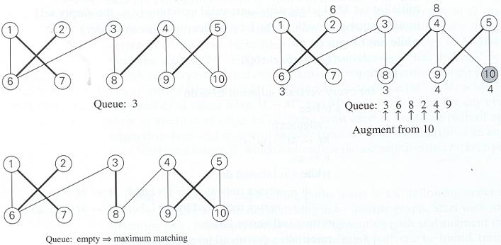
Example :

Slide 73
Maximum Matching in Bipartite Graphs
Analysis :
  Each iteration except the last one matches two previously free vertices
    One from each of the sets V and U
  Total number of iterations can not exceed n/2+1
    n=|V|+|U| is the number of vertices in the graph
  Time spent on each iteration is in O(n+m)
    m=|E| is the number of edges in the graph
    This assumes that information about the status of each vertex can be retrieved in constant time by storing it in an array
  Hence, time efficiency of algorithm is in O(n(n+m))

Slide 74
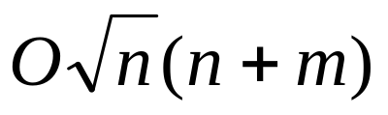
Maximum Matching in Bipartite Graphs
Discussion:
  Time efficiency of the algorithm can be improved to
  We were concerned ith matching the largest possible number of vertex pairs in a bipartite graph
  Some applications may require taking into account quality or cost of matching different pairs

